Slide 1

Governor’s Office of Science, Innovation & Technology
www.osit.nv.gov/broadband
For the “Planning, Mapping & Procurement of Broadband Activities”

Slide 2
.
Broadband
Transportation
IMPLEMENTING A “DIG ONCE” POLICY
  2012 Executive Order to facilitate deployment of BB on federal lands, ROWs, federally assisted highways and tribal lands. Urged collaboration between agencies and USDOT to work with state and local agencies to implement policies that could facilitate BB deployment.
DIFFERENT TYPES OF “DIG ONCE” PRACTICES
GOAL – MINIMIZE EXCAVATIONS AND COSTS

Slide 3
reviewing best practices IN
OTHER STATES & 2016 TASK FORCE RECOMMENDATIONS led to Sb 53
  S.B. 53 is a bill that addresses three key areas:
  Expands the role/responsibilities of OSIT
  Allows public records concerning fiber infrastructure, maps, diagrams, etc. to be brought under the umbrella of critical infrastructure or homeland security so as to allow an agency to declare these records confidential.
  Takes the best practices implemented by the Utah DOT and implements them here in Nevada.

Slide 4
The need for change – CURRENT RESTRICTIONS ON NDOT:
  Current definition of “transportation facility”
  Restrictions on using highway funds for anything other than “transportation facilities.”
  Restrictions on working with private companies

Slide 5
Fiber trading – what is it and how will it work?
  ADVANCED PLANNING – Regular engagement with telecoms; Solicitation of annual “wish list”
  HIGHWAY PROJECTS/EXPANSION OF THE ITS SYSTEM – highway projects will receive additional conduit
  ESTABLISH VALUE – Cost of the conduit, fiber, trenching, etc. will be value. Values will be reviewed by Council who will ensure they are fair and reasonable.
  OFFER TRADE – Can include any other type of fiber/communication asset in any other location. Not just “conduit for conduit.”
  TRADES PREFERABLE – Keep balance on the books. Ability to bank values.
Notes:
80 – 90% of the cost of building out fiber is incurred in getting that fiber line in the ground. Additional cost of conduit is a small “add” to the overall project cost. If conduit is already in the ground, it makes deployment much easier, and faster.

Slide 6
UDOT Example
Trade with Crown Castle International, a wireless infrastructure company that supports all carriers
  Crown Castle received:
    Built a fiber-optic backbone in the ROW
    Wireless towers in ROW
    Use of UDOT fiber conduit
    Hub building on UDOT ROW
    UDOT received:
      24 strands of fiber cable
      Spare conduit
      Access to all poles for equipment Road Weather Information System installed
      Power for devices
      Hub space for equipment.

Slide 7
TAKE AWAY:
    core principles:
    Make access to the ROWs easier
    Be cooperative with other state and federal agencies.
    Keep the ROW open at all time (no exclusive access by any one company)
    Stay carrier agnostic
    Be fair and reasonable – in conduct and pricing. The goal is to incentivize telecoms
    This policy has:
    Facilitated expansion of fiber infrastructure by reducing deployment time and costs.
    Helped expand fiber infrastructure into underserved areas
    Helped communities understand how to attract fiber telecom providers
      a. Let them use DOT standards for construction
      b. Attend planning meetings to help with coordination.

Slide 8
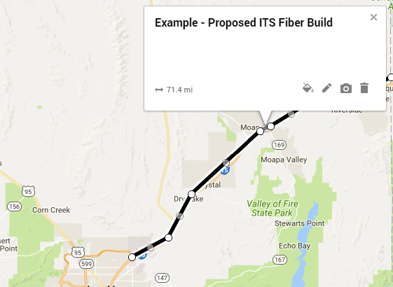
Nevada Example
Notes:
Suppose NDOT wants to expand ITS system on I-15 North to Mesquite.
Install excess conduit. Assume telecom #1 wants to deploy fiber along that ROW and wants to use the NDOT conduit. NDOT will place a value on that conduit and Telecom #1 would need to provide something of equal or greater value in return. What it is can vary.

Slide 9
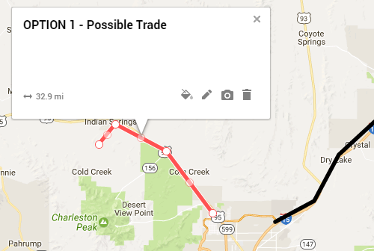
NEVADA EXAMPLE
Notes:
Option 1? Maybe NDOT would want dark fiber on US 95 to Indian Springs – lateral to ISCC

Slide 10
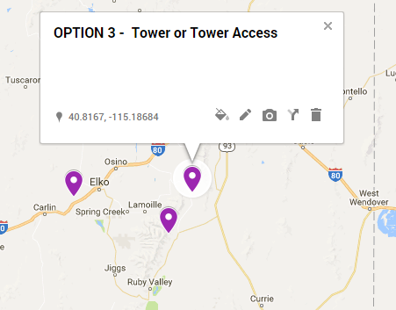
Nevada example

Slide 11
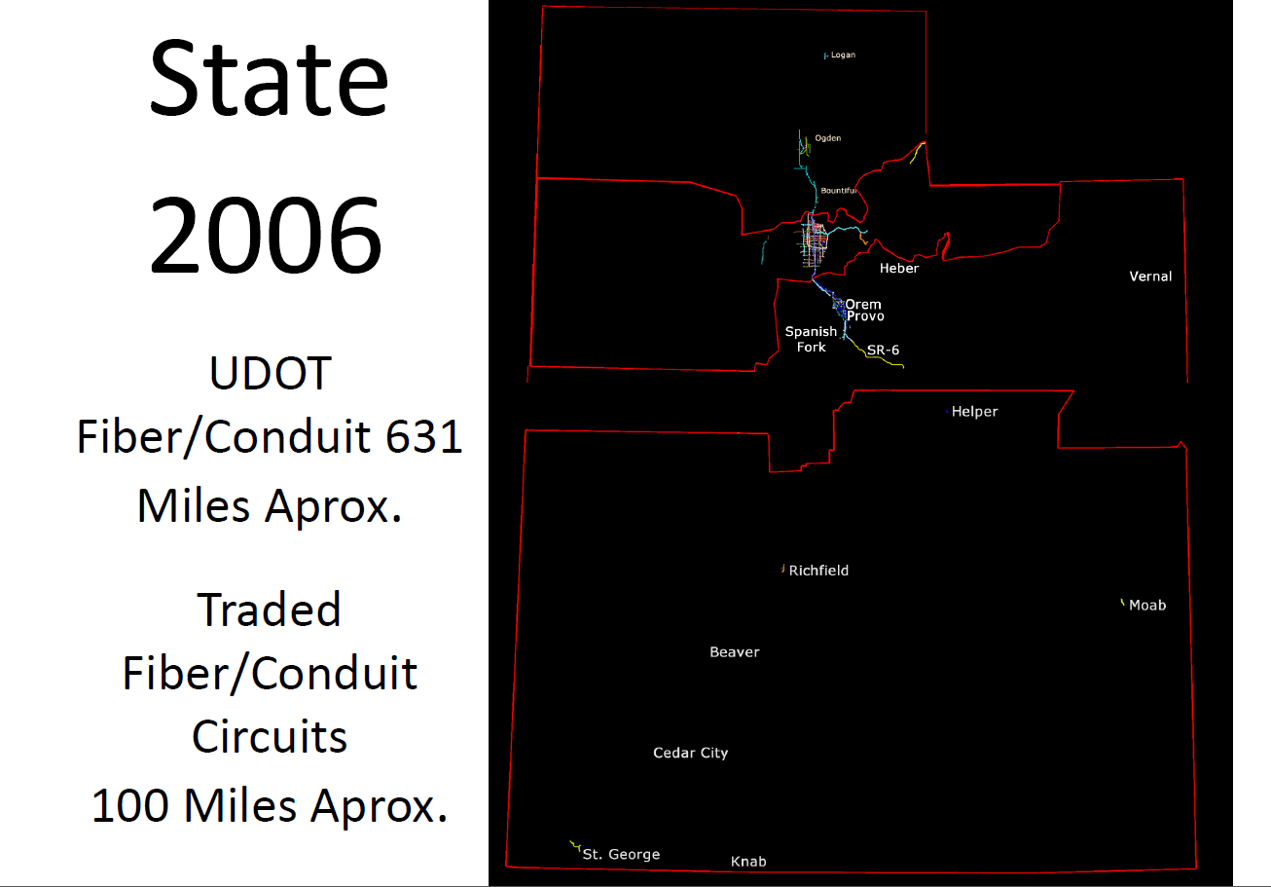

Slide 12
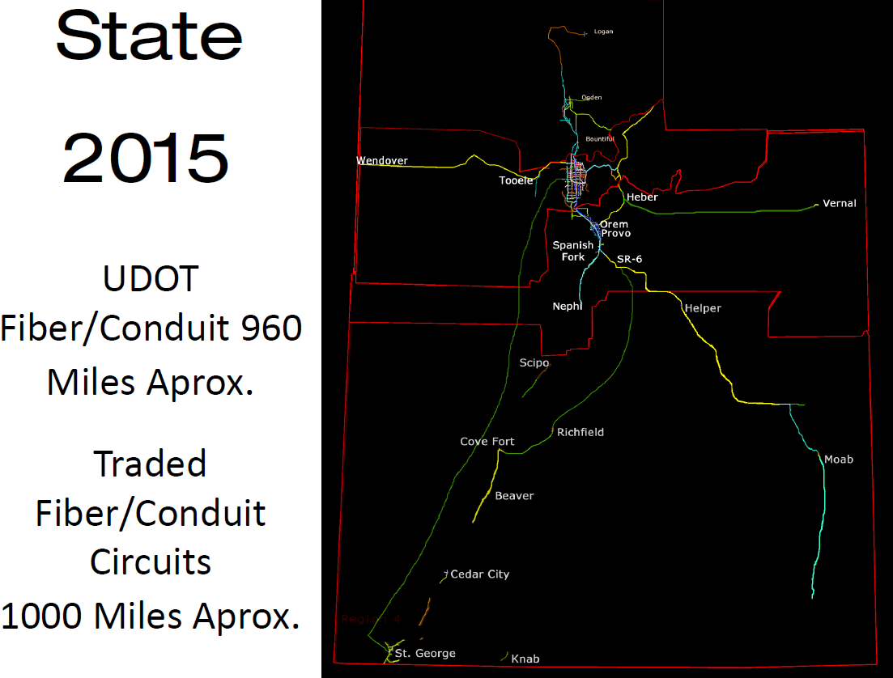

Slide 13
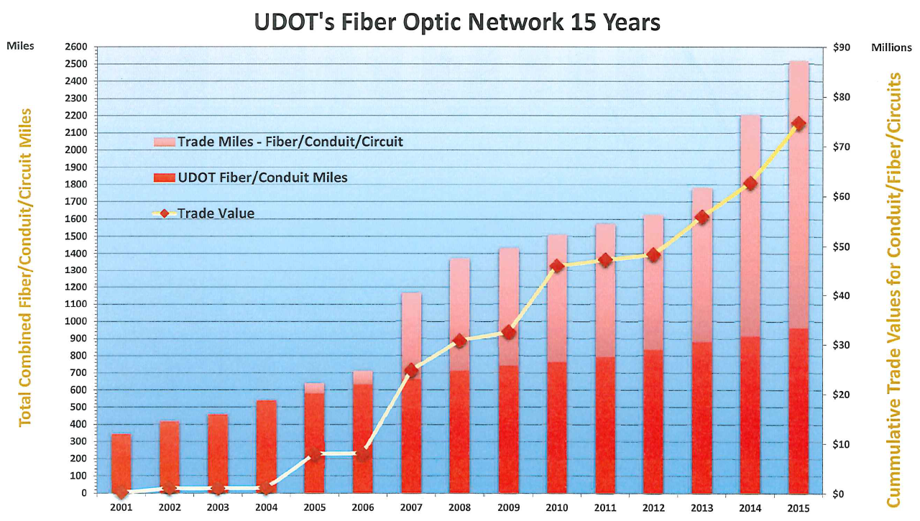

Slide 14
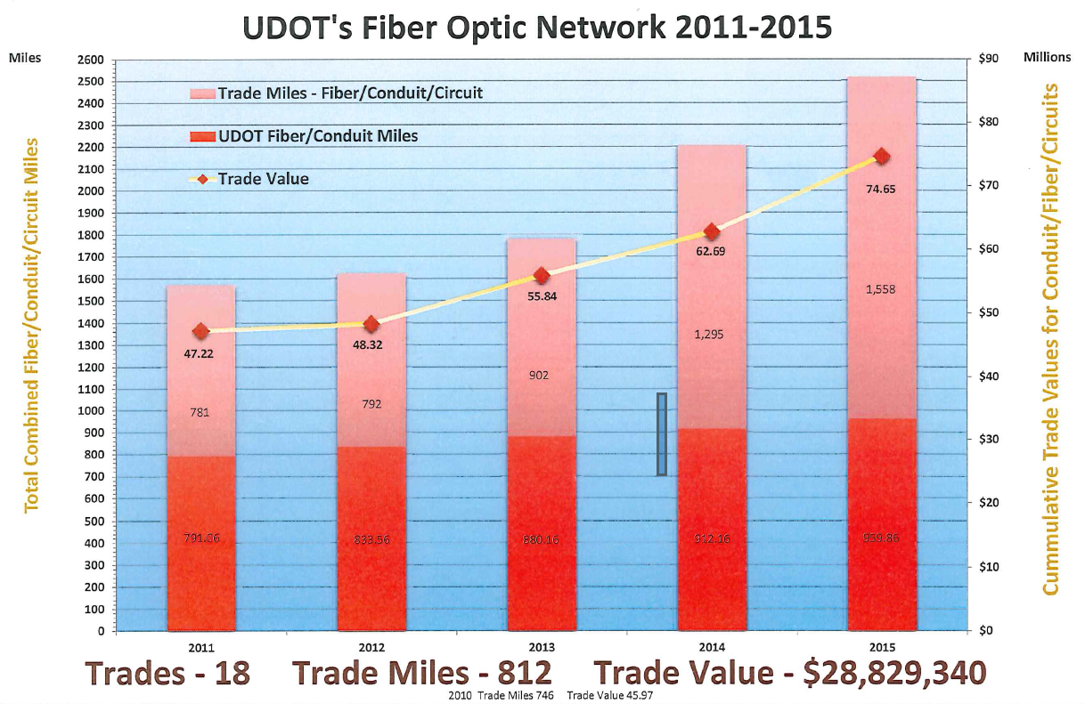
RETURN ON INVESTMENT
.

