Slide 1
FCC Rural Broadband Experiments
Maps of Potential CAF Funding Areas in California

Slide 2
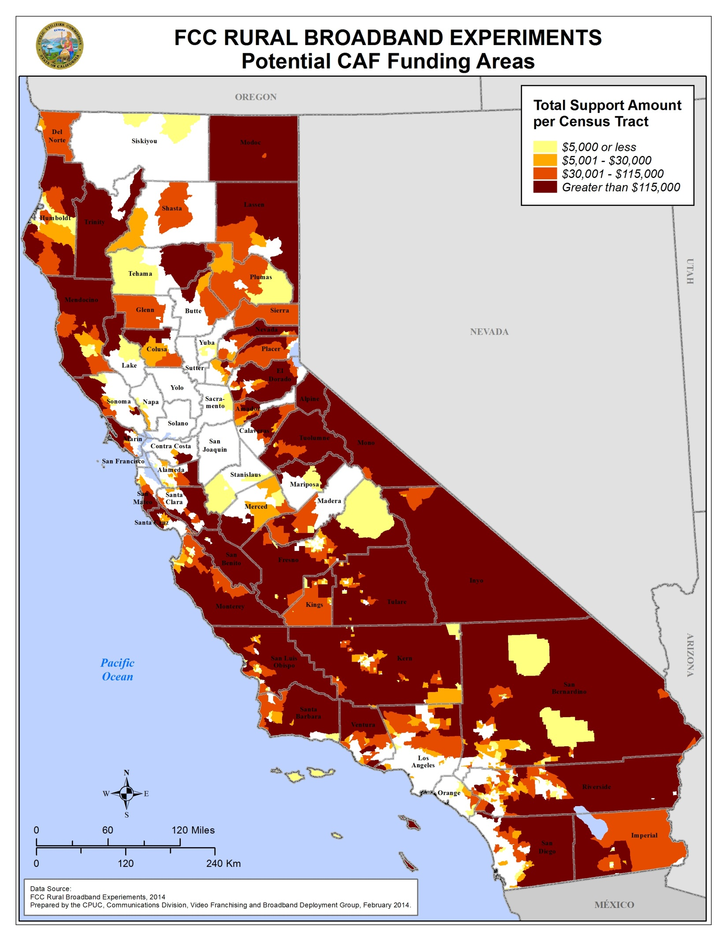

Slide 3
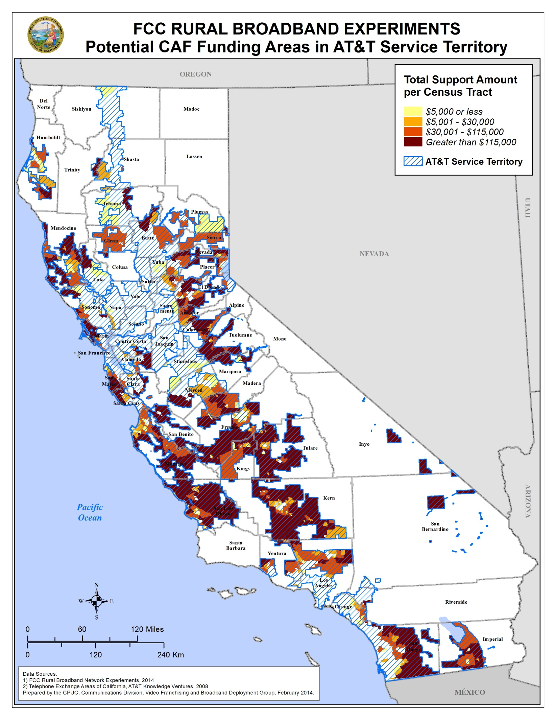

Slide 4
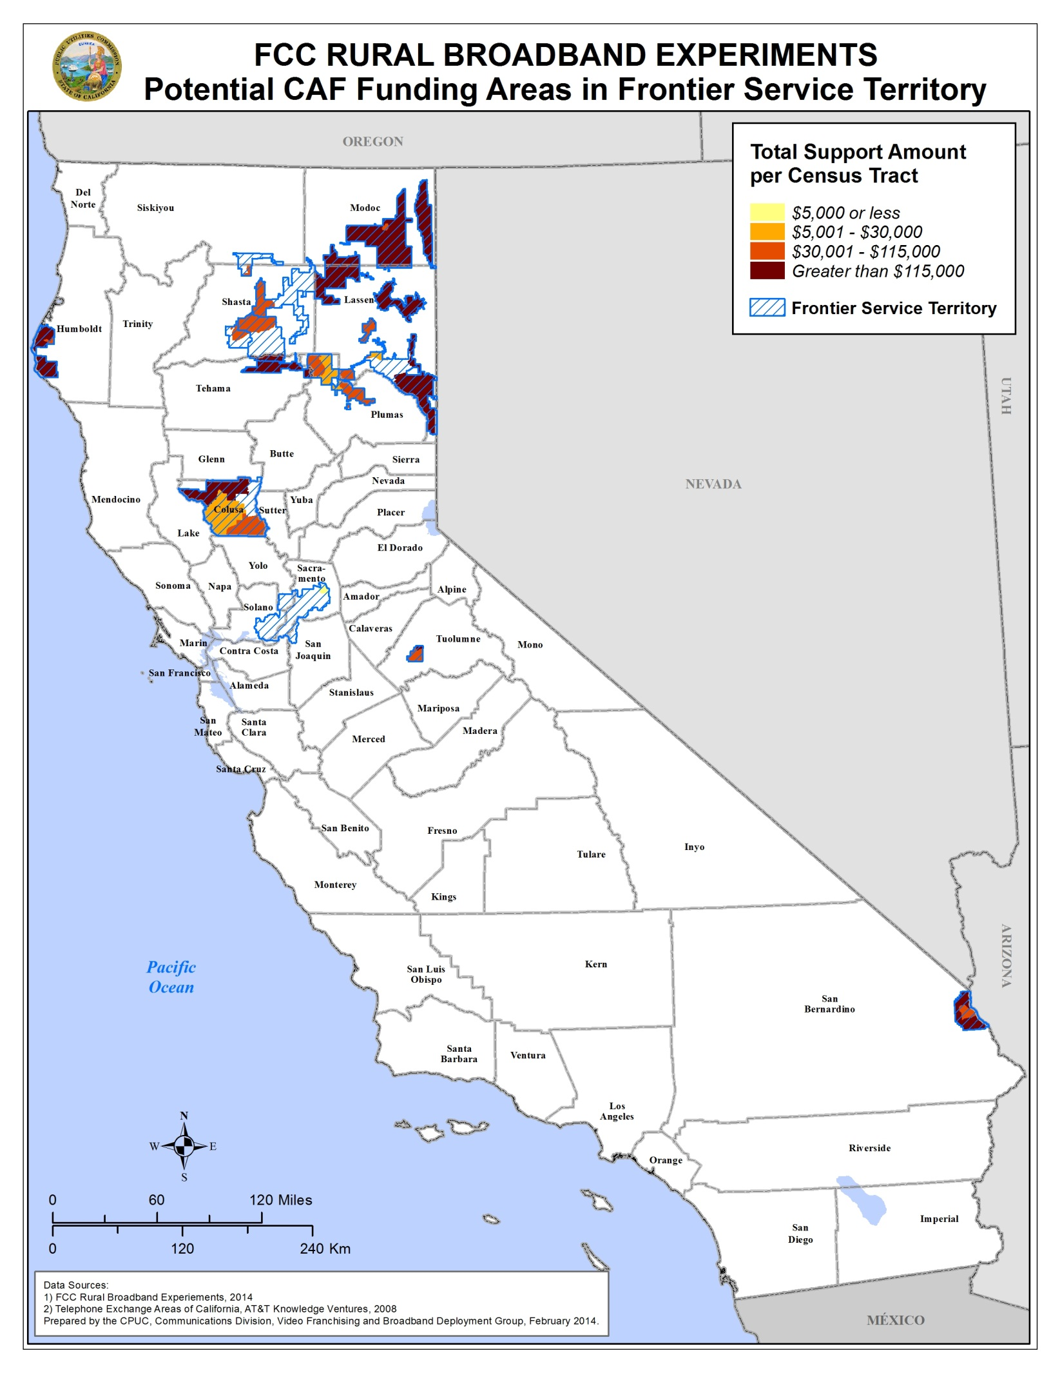

Slide 5
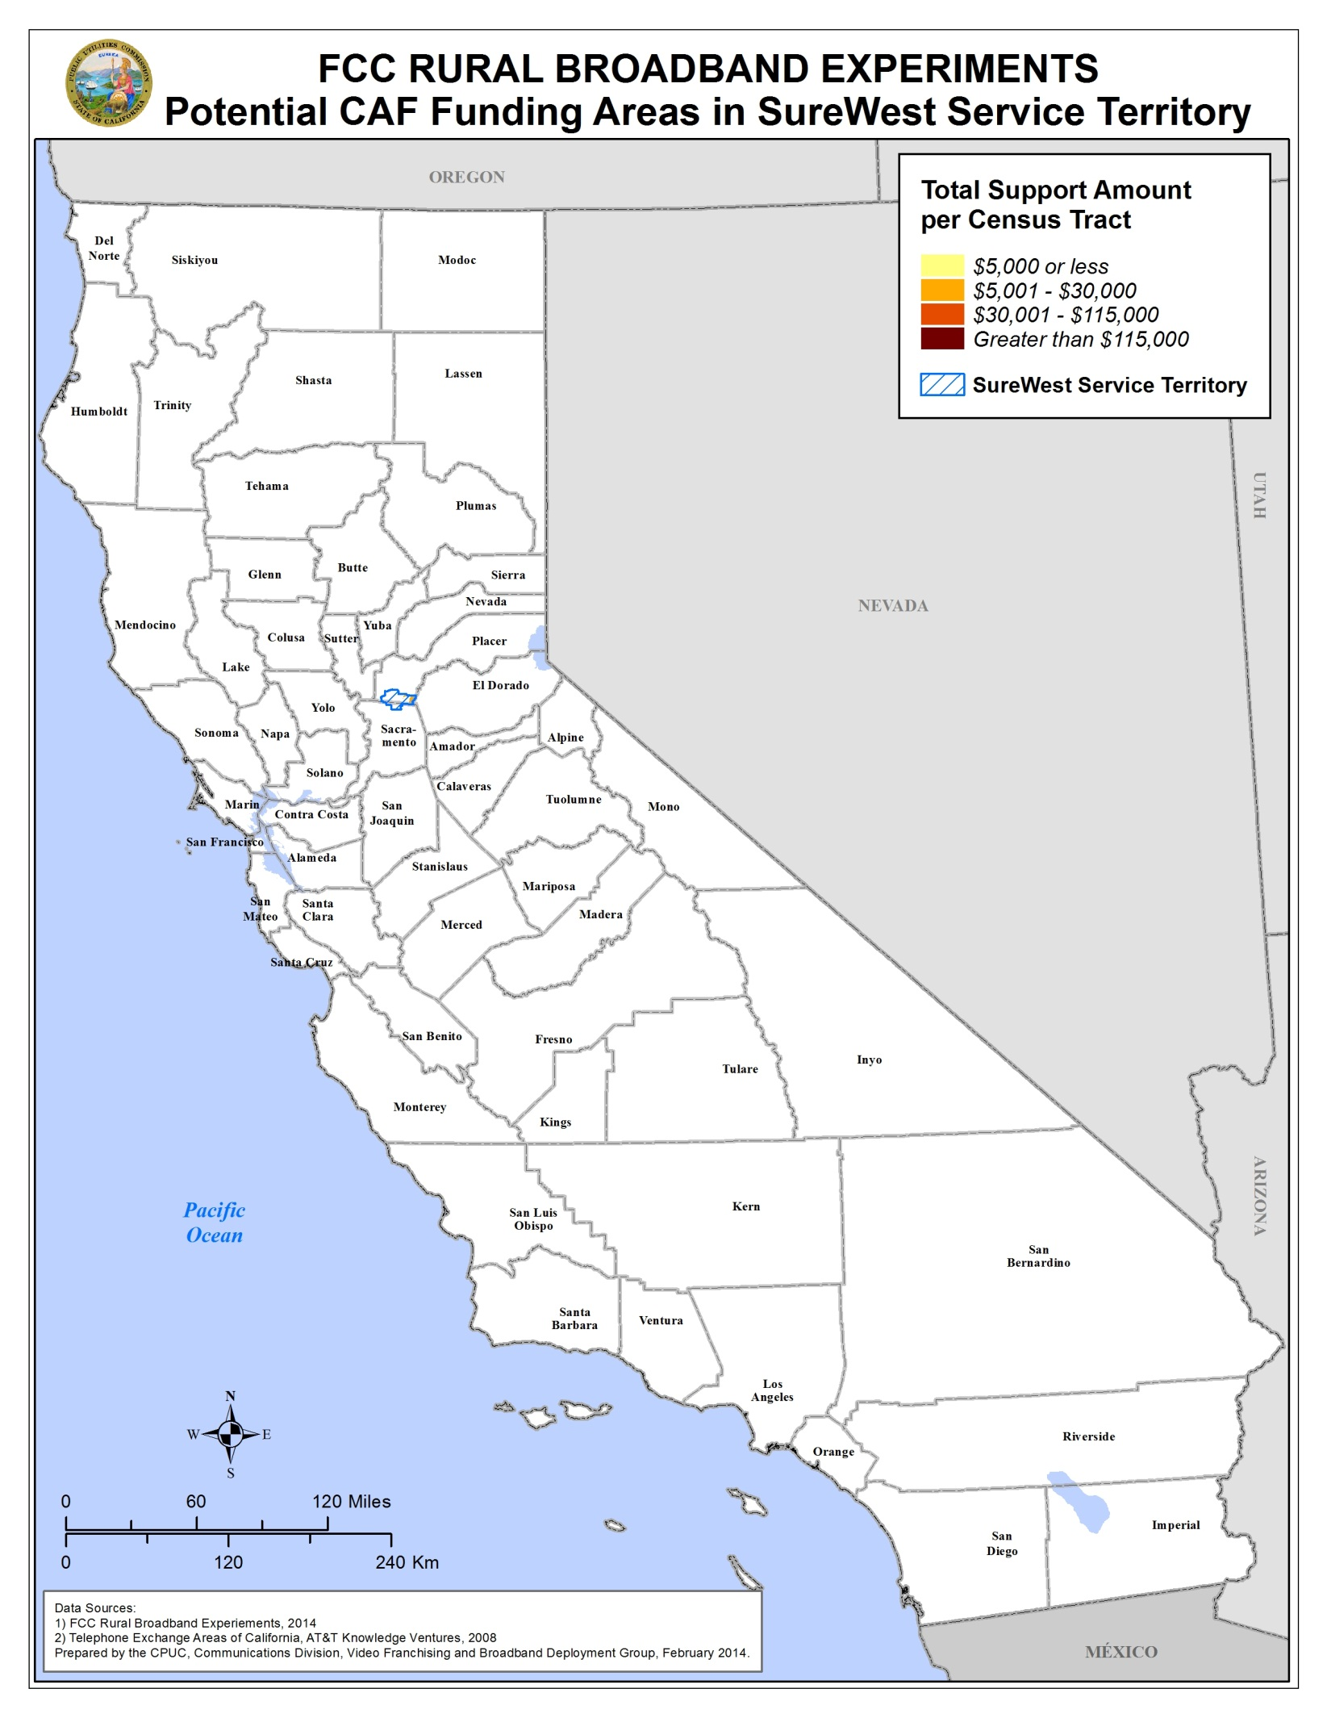

Slide 6
